Slide 1



Intermediate
Programming
WEEK 3 – Exception Handling

Slide 2
Outline
Exception
Error vs. Exception
Types of Exception
Exception Handling Techniques

Slide 3
ENERGIZER Find the odd one out

Slide 4
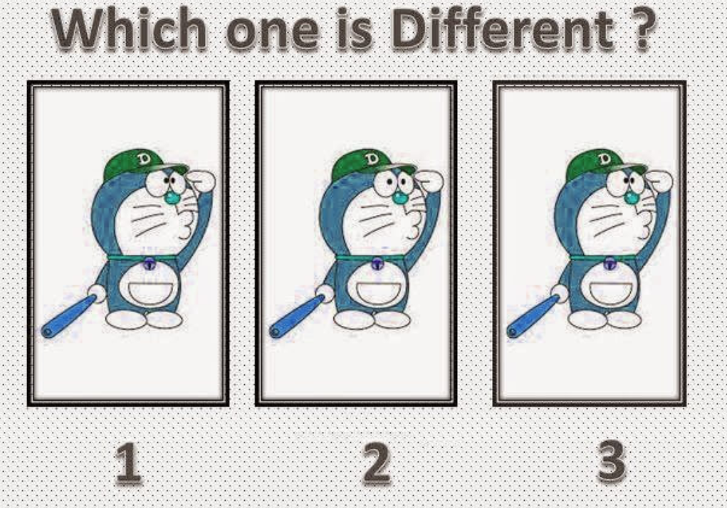

Slide 5
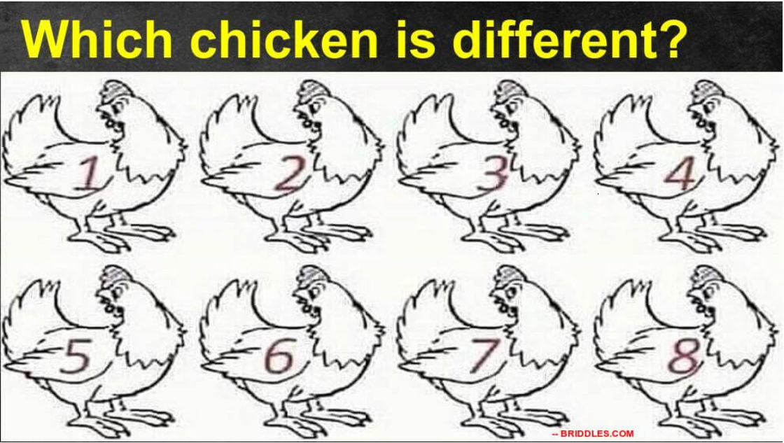

Slide 6
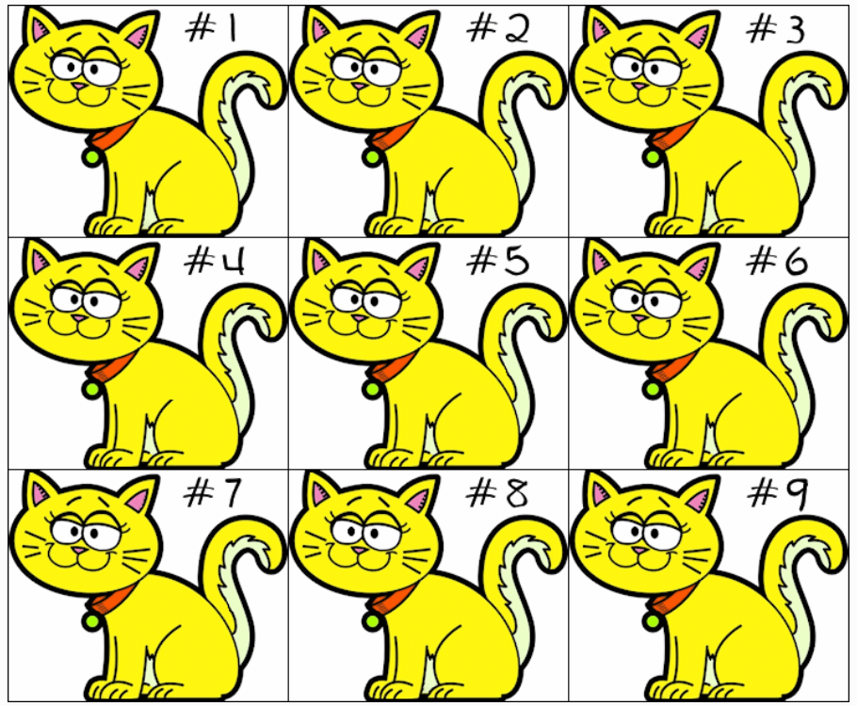

Slide 7
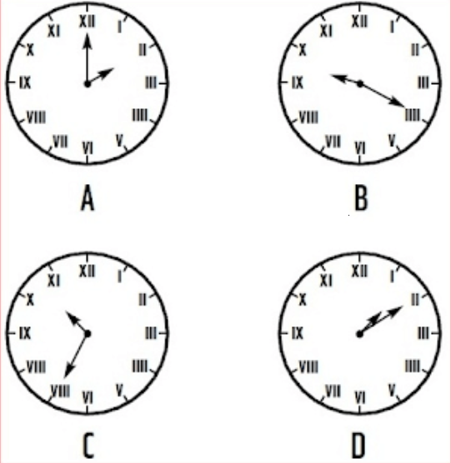

Slide 8
Exception?
Dictionary definition:
Exception is an abnormal condition
In Java:
An exception is an event that disrupts the normal flow of the program. It is an object which is thrown at runtime.

Slide 9

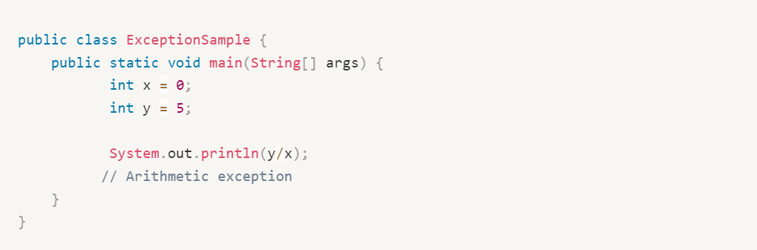
Mathematical Error
Dividing a number by zero

Slide 10
What causes an exception?
There are many causes of why exceptions occur, some of which are:
A file indicated in the program cannot be found.
A mathematical error in the program.
An invalid input from a user.
The JVM ran out of memory.

Slide 11
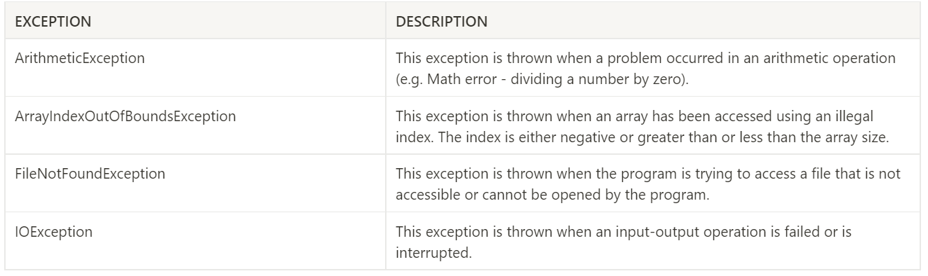
Some built-in exceptions

Slide 12
Error vs. Exception
ERRORS – irrecoverable, cannot be handled.
Example: OutOfMemoryError, VirtualMachineError
EXCEPTIONS – can be handled.
Checked exceptions – checked at compile time (e.g., IOException)
Unchecked exceptions – checked at runtime (e.g., NullPointerException)

Slide 13
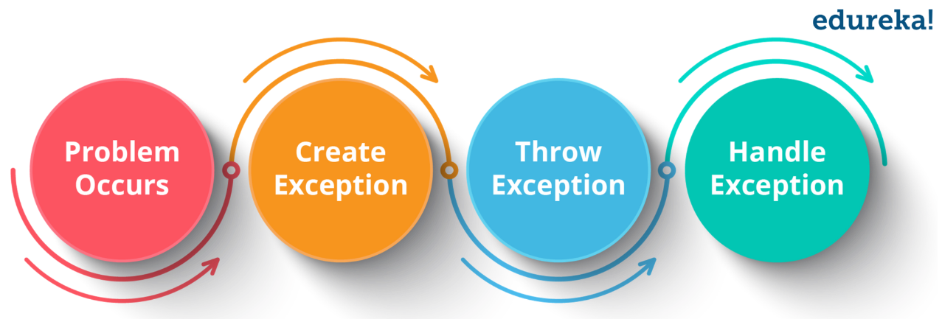
How to handle exceptions?

Slide 14
Exception handling keywords
try-catch
A block of code where the exception is expected should be surrounded by the try-catch block. try indicates the start of the exception handling block and the catch keyword indicates the end.
The catch block is responsible for handling the identified exception. The catch block will only catch the specified exception, otherwise, the program will be terminated. There can be multiple catch blocks for a try block.

Slide 15
Exception handling keywords
finally
The finally keyword is declared after the catch block. This block is always executed whether an exception is handled or not. The finally block is used when there is a block of code that must always be executed. For instance, closing a file or a database connection.

Slide 16
SAMPLE PROGRAM

Slide 17
Exception handling keywords
throws and throw
The throws keyword is declared in the method signature. This can be used to throw multiple exceptions.
The throw keyword is used to indicate the problem condition. This is used to throw an exception

Slide 18
SAMPLE PROGRAM

Slide 19
Intermediate
Programming
WEEK 3 – Exception Handling

